Slide 1
Capstone Presentation- House Pricing
Submitted on 21-Nov-2020
Renjith Mohan K

Slide 2
Business Problem Understanding
We need to predict the right price for a house in Washington, US localty for a given attributes associated it by building a ML model from the dataset that was provided to us.
There are a number of features associated with a house's price and it is a tedious job to manually derive insights from the data available to us. Also the location of the houses were not given in the dataset but rather zip locations along with lat and long values were provided.
The scope of this project is limited to the dataset that we have for 21K odd house pricing records obtained from Washinton state location in US for the years 2014-2015.
The objective of this project is to create a ML model with the best algorithm that help us determine the right price of a house with best accuracy and also to derive insights on the important factors that influence a houses's price so that there will be cost savings in future by offering the right price for a given house on sale.

Slide 3
Modelling Approach Used
Since our target variable is “House Price” which is numeric in nature, we have used multiple models that uses regression analysis or those which can deal with numeric data as output.
As a primary approach, we built individual models. This was done to assess the performance of each model with the given dataset. The models used were - 1) Linear Regression 2) Ridge Regression 3) DecisionTree Algorithm and 4) KNN Algorithm
At the secondary level we built models using ensemble method where multiple models were combined together.This was done to improve the performance of the individual models. In this project we combined the above 4 individual models by stacking and then also used Random Forest as an ensemble model.
Finally we applied tuning to the best ensemble model to fine tune the performance. We did tuning on the Random Forest model which turned out to be the best Ensemble model in our analysis.

Slide 4
Insights From Analysis
Insights from EDA - Univariate-I:
The target variable- “Price” follows a right skewed distribution such that we see most of the house prices falls under 300K - 500K range. However we also see an increase in no: of house with prices greater than 1 million.
The feature “Year_Built” follows a left skewed distribution and indicates that most of the houses in our dataset have the build after the year 2000.We reconfirm this trend with “House Age” parameter being max for the values 5 to 10 years.
The featues- ceil_measure and living measure, lot_measure15 follows a right skewed distribution where as the features- Percent_carpet_area and living_measure15 closely follow a normal distribution.
We dont see a particular distribution applicable for the total_area parameter and it is scattered unevenly across.

Slide 5
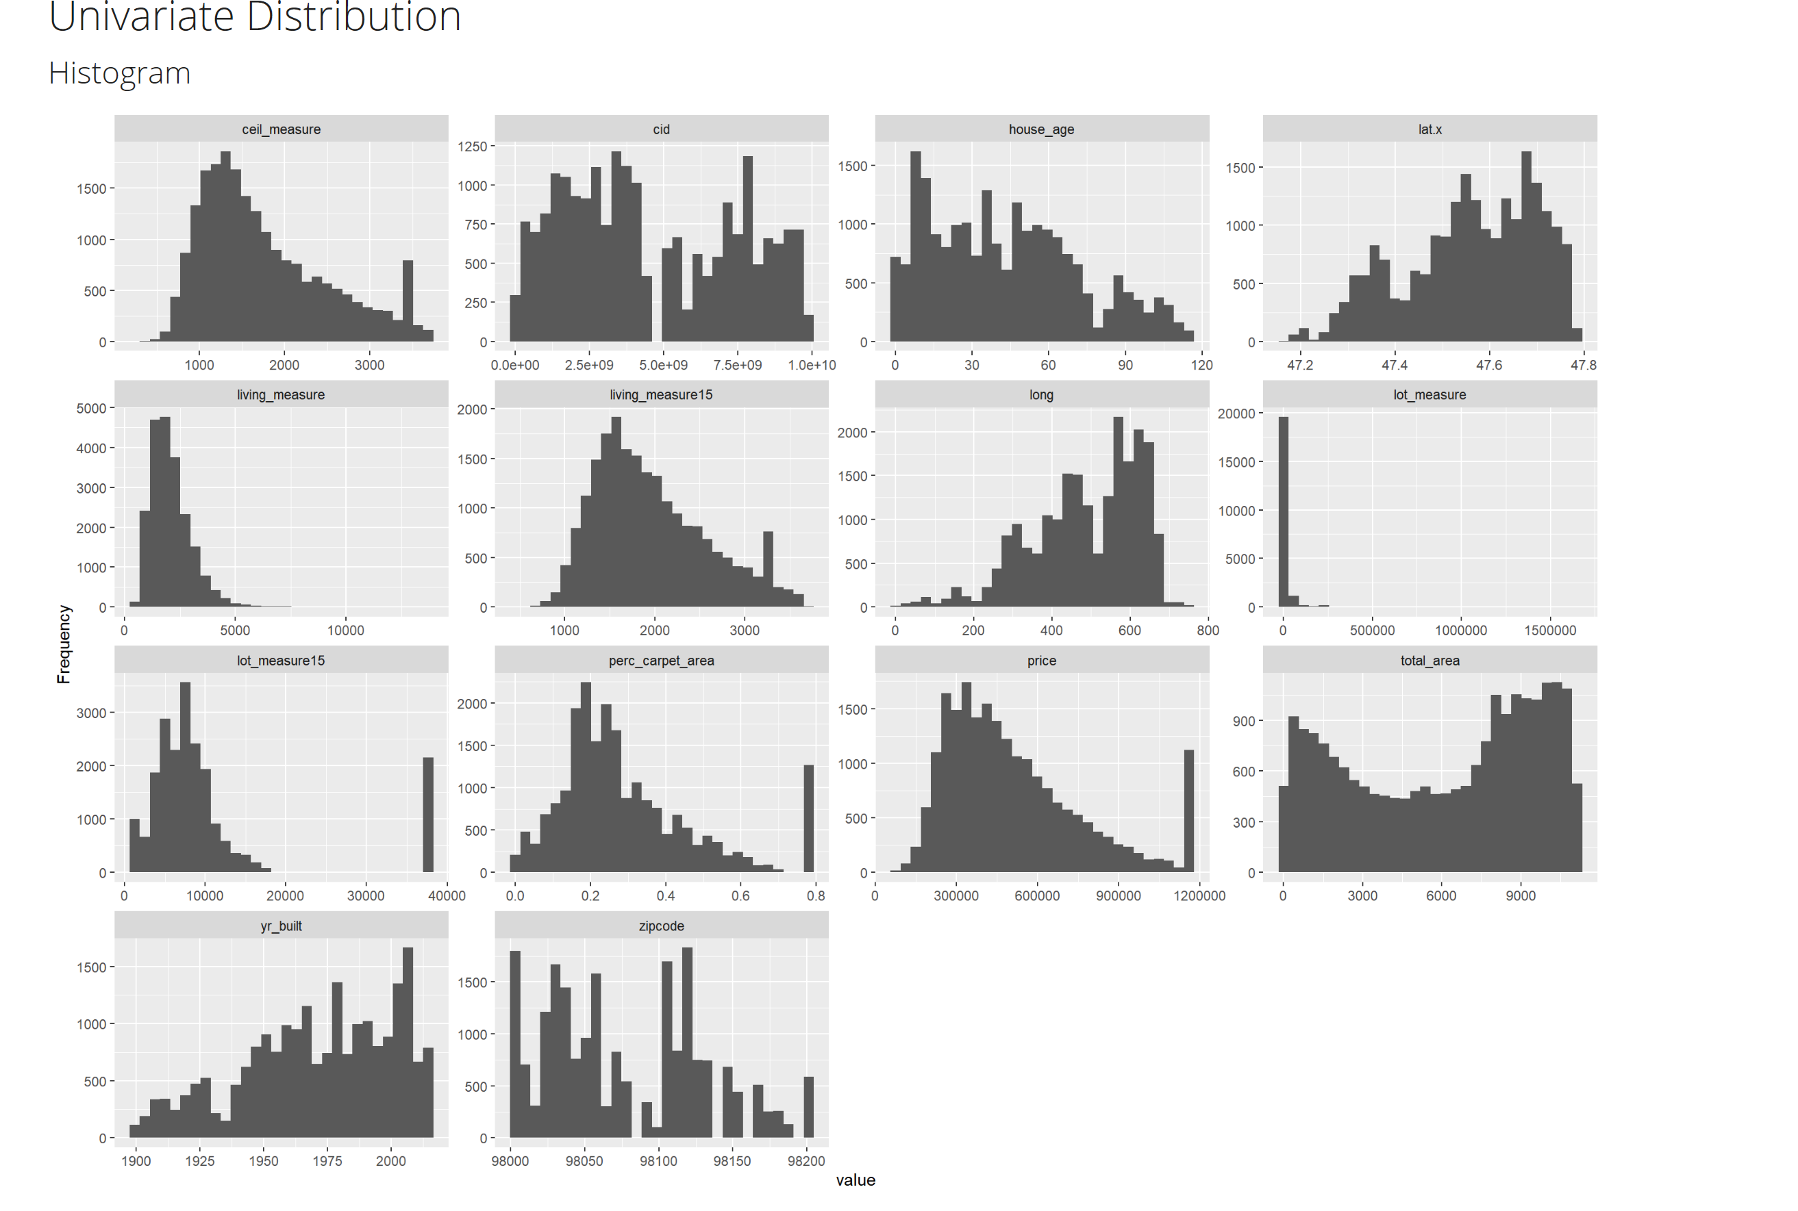
Insights From Analysis
Insights from EDA - Univariate-I plots:

Slide 6
Insights From Analysis
Insights from EDA - Univariate-II :
We observed that most of the entries in our dataset have
3 bedrooms and 2.5 bathrooms
Majority of the entries in our dataset has a value of
Ceiling=1, Condition=3 & Quality=7
Majority of houses in our dataset belong to the city- Seattle
Majority of houses in our dataset doesnt have a Coast and most of them were sighted only once.
Majority of houses in our dataset are neither furnished nor renovated or have a basement.

Slide 7
Insights From Analysis
Insights from EDA - Univariate-II:

Slide 8
Insights From Analysis
Insights from EDA - Bivariate-I:
As a general trend we see that the house price increases as the no: of bed rooms increase.A similar kind of trend was noticed for no: of bathrooms too.
The house prices showed an increase for ones that were sighted more than one time. The prices were directly proportional to no: of sights.
The house prices were found highest for ceiling value of 2.5 .
The house prices were directly proportional to the features - House Condition and Quality .
The house prices showd a direct positive correlation with the basement area of the house.

Slide 9
Insights From Analysis
Insights from EDA - Bivariate-I Plots (wrt price):

Slide 10
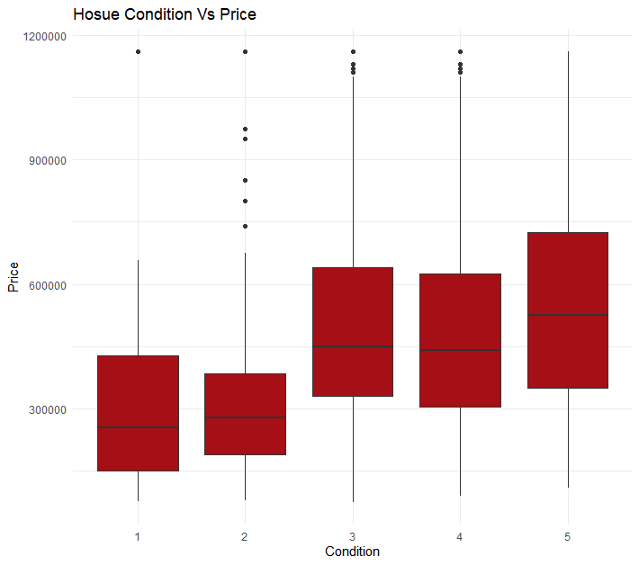
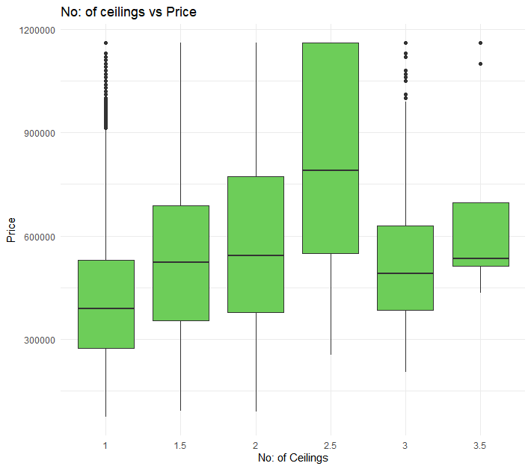
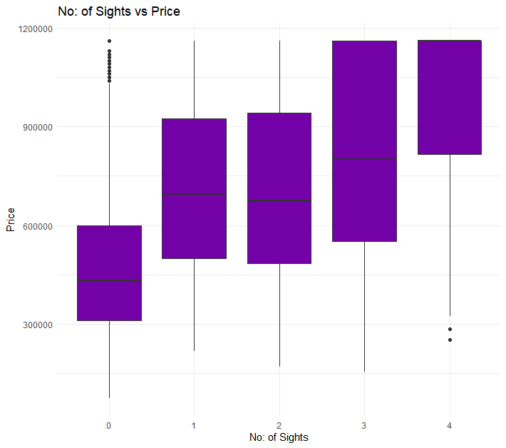
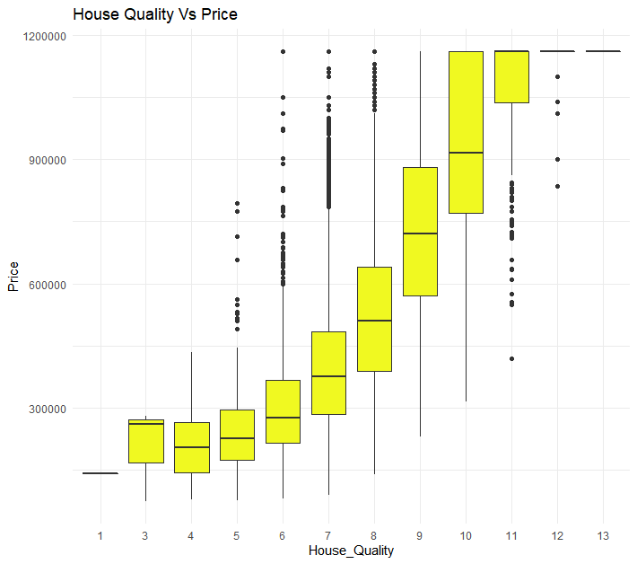
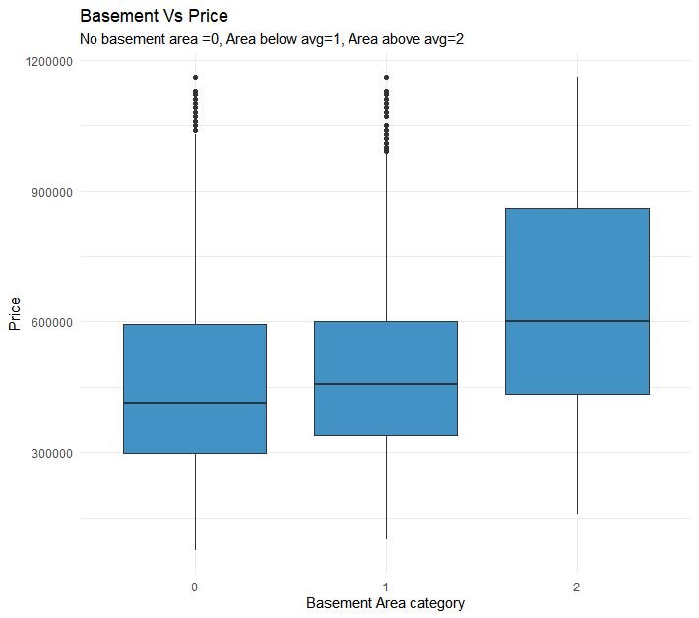
Insights From Analysis
Insights from EDA - Bivariate-I Plots (wrt price)Cont'd:

Slide 11
Insights From Analysis
Insights from EDA - Bivariate-II by City:
We observed that Seattle is the city with most data points and Medina with the least.
For the features Living_Measure15 & Ceil_measure, we see a positive correlation with price for all cities in our dataset.
For the feature House_Age, we see a negative correlation with price for all cities in our dataset except for Seattle & Medina.
For the features lot_measure15 & total_area, we dont have a good correlation with price for any of the cities.
We observed the costliest houses are located mostly in the states - Medina, Mercer Island, Kirkland, Bellevue, Seattle & Sammamish.
We observed that most of the old houses are located in the cities- Seattle & Renton .

Slide 12
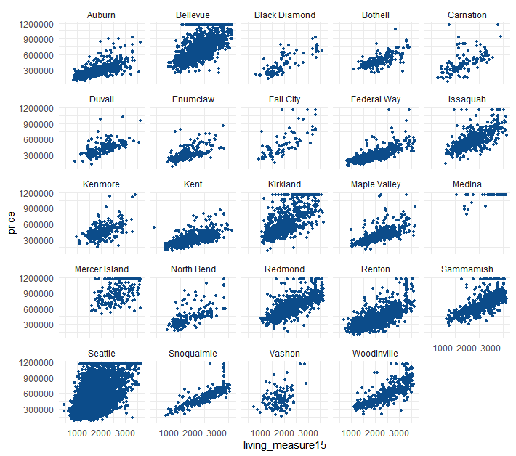
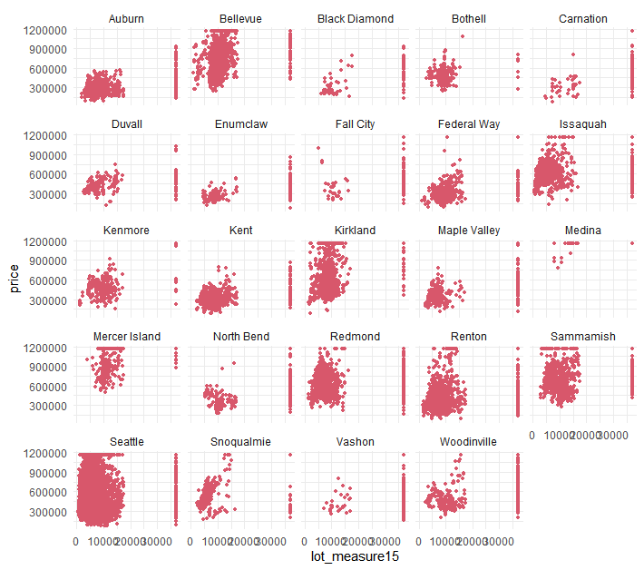
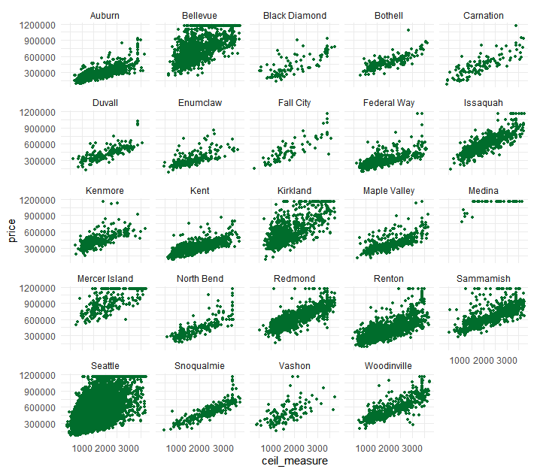
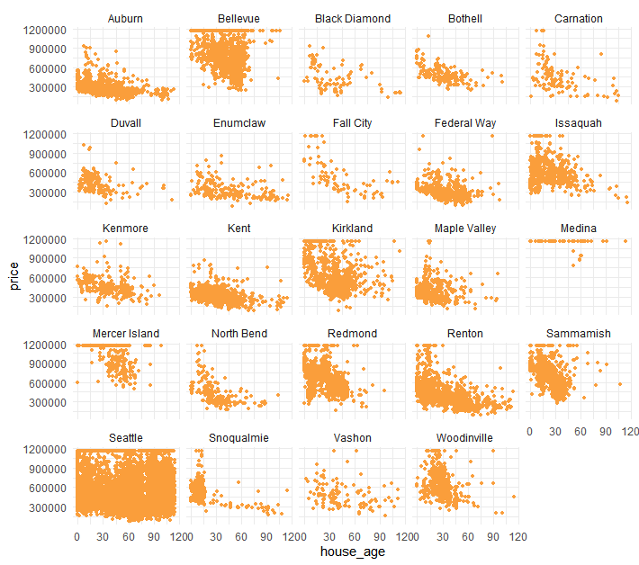
Insights From Analysis
Insights from EDA - Bivariate-II by City Plots:

Slide 13
Insights From Analysis
Insights from EDA - Multi Collinearity:
The features - “Furnished” and “Quality” was found to have a positive correlation value of 0.79 in our analysis.
The features - “Ceil_measure” and “Quality” was found to have a positive correlation of 0.74 in our analysis.
The features -”Ceil_measure” and “Living_measure15” was found to have a positive correlation of 0.73 in our analysis.
The features- “Living_measure15” and “Quality” was found to have a positive correlation of 0.7 in our analysis.
The features- “Lot_measure15” and “Perc_Carpet_Area” was found to have a negative correlation of 0.6 in our analysis.
The features- “Room_Bath” and “House_Age” was found to have a negative correlation of 0.5 in our analysis.

Slide 14
Insights From Analysis
Insights from EDA - Multi Collinearity Plots:

Slide 15
Insights From Analysis
Insights from Models - Linear Regression & Ridge Regression :
We see from the Linear Regression that the most significant factors/coefficients affecting the house price are Quality , Ceil_Measure & House_Age and the prices were directly proportional to them.
The number of bed rooms ( room_bed) was having an inversely propotional relationship with the house price. The variables Total_Area, Coast, Lot_measure15 , Ceil & Renovated status seems to have less influence on the housing price.
The house prices are most impacted by the locations - Seattle, Bellevue, Kirkland, Mercer Island, Redmond and Sammamish such that these cities have a positive impact on housing price.
The cities -Federal way was found to have a negative influence on price and other cities which really didn’t impact the price are - Kent and EnumClaw.
From Ridge regression we noticed that Perc_Carpet_Area and Coast are significant faetures along with Medina, Mercer_Island, Bellevue,Kirkland ,Redmond & Sammamish as prominent cities in deciding the housing price.

Slide 16
Insights From Analysis
Insights from Models - Linear Regression Tables:
Linear Regression- Variable Importance
major_cityBellevue 100.00
major_cityKirkland 75.69
`major_cityMercer Island` 75.48
quality 72.88
major_cityRedmond 70.89
major_citySeattle 69.84
house_age 66.43
ceil_measure 65.07
major_citySammamish 54.53
basement_new 47.87
major_cityIssaquah 46.60
major_cityMedina 43.79
major_cityWoodinville 39.34
sight 35.51
condition 31.46
perc_carpet_area 26.55
major_cityKenmore 25.08
furnished 22.50
major_cityRenton 22.44
`major_cityNorth Bend` 22.03
Ridge Regression- Variable Importance
major_cityMedina 100.00
major_cityMercer Island 73.12
major_cityBellevue 56.54
major_cityKirkland 41.14
major_cityRedmond 38.19
perc_carpet_area 30.87
coast 28.84
major_citySammamish 27.64
major_cityFederal Way 26.96
major_citySeattle 26.29
major_cityFall City 25.90
major_cityIssaquah 21.53
major_cityWoodinville 21.29
major_cityKent 20.51
furnished 19.17
quality 16.10
major_cityEnumclaw 15.27
major_cityVashon 12.70
major_cityCarnation 12.28
major_cityMaple Valley 11.77

Slide 17
Insights From Analysis
Insights from Models - KNN, Decision Tree & Ensemble Models:
The most important variables from KNN algorithm was Quality followed by living_measure15, ceil_measure and Furnished. While the variables coast, renovated & condition were found the least influential.
We noticed that the most important variables from Decision tree regression were Quality followed by major_cities as Auburn/Black_Diamond and then House_Age.
The most important variables identified from Random Forest were Quality, Furnished, Living_Measure15 while the least important variables were coast, renovated and ceil.
The important variables identified from Random Forest tuned algorithm were Quality, Major_City, Furnished and Living_Measure15 and the least important variables noticed were Renovated and Coast.

Slide 18
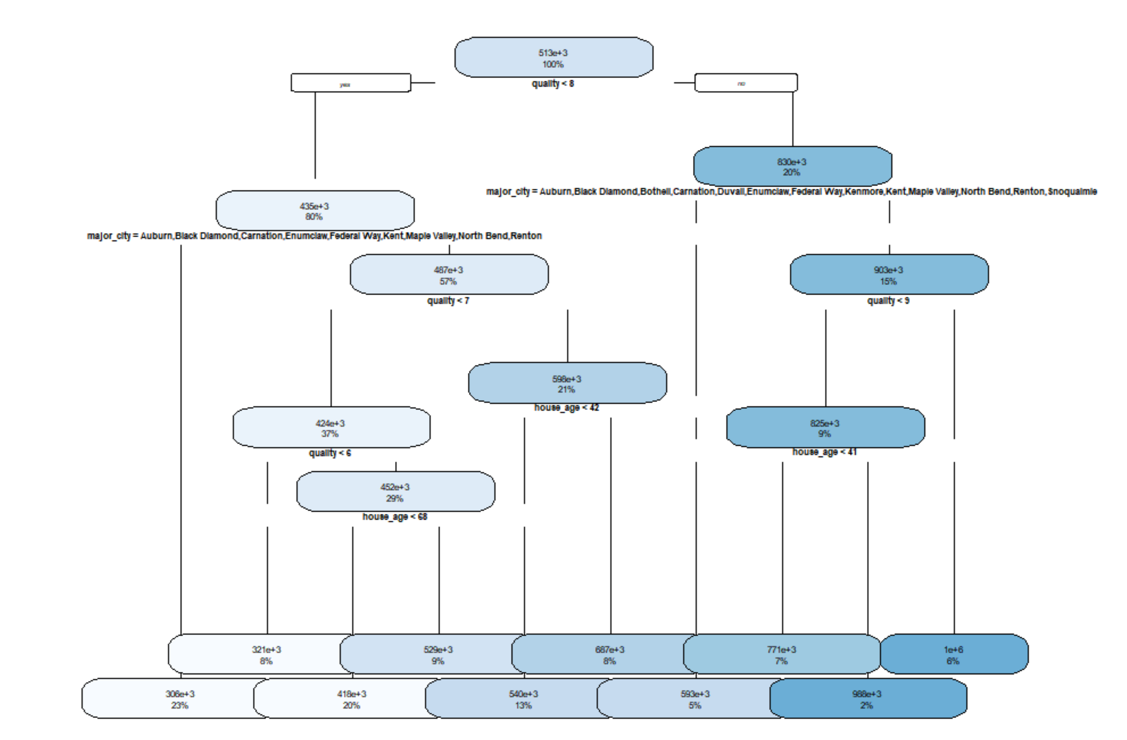
Insights From Analysis
Insights from Models - KNN,DecisionTree &Ensemble Models Tables:
KNN Regression- Variable Importance
quality 100.0000
living_measure15 82.2783
ceil_measure 77.9959
furnished 74.0201
room_bath 59.4855
major_city 58.8808
sight 24.0969
room_bed 22.9331
ceil 19.0912
perc_carpet_area 18.1640
basement_new 13.3051
lot_measure15 12.4943
house_age 11.7617
total_area 5.3364
coast 2.8478
renovated 0.4982
condition 0.0000
Model Type | Stacking - Overall
Base + Predictor | KNN_pred | 100
Base | LR_pred | 72.88
Base | Ridge_pred | 68.19
Base | DT_pred | 0
RF Tuned- Variable Importance
room_bed 7.780874e+12
room_bath 3.263300e+13
ceil 4.787430e+12
coast 2.695474e+12
sight 1.114056e+13
condition 8.410487e+12
quality 3.474175e+14
ceil_measure 7.630300e+13
living_measure15 8.949599e+13
lot_measure15 2.573696e+13
furnished 1.095042e+14
total_area 2.268245e+13
major_city 1.967593e+14
house_age 6.392995e+13
renovated 1.831511e+12
perc_carpet_area 3.385844e+13
basement_new 1.223504e+13
RF Regression- Variable Importance
room_bed 1.276847e+13
room_bath 5.760015e+13
ceil 7.626146e+12
coast 2.742272e+12
sight 2.094761e+13
condition 1.090458e+13
quality 2.179364e+14
ceil_measure 9.693222e+13
living_measure15 1.250165e+14
lot_measure15 3.164283e+13
furnished 1.265434e+14
total_area 2.438731e+13
major_city 1.862151e+14
house_age 5.775283e+13
renovated 2.900216e+12
perc_carpet_area 3.945801e+13
basement_new 1.975719e+13

Slide 19
Insights From Model
Insights from Model Performance - All Models:
Among the individual models, the best performance was obtained using the KNN algorithm for the metrics - RSquare, RMSE, MAE, & MAPE
There was a slight improvement in performance when we used the stacked ensemble model with the predictor model as KNN.
The Random Forest ensemble model gave a better performance than the stacking ensemble model by over 10% better R-Square value and 1% MAPE reduction.
The Random Forest ensemble model with tuning very slighly improved the performance by around 0.5% increase in R Square value.

Slide 20
Insights From Model
Insights from Model Performance - All Models Table Metrics:

Slide 21
Recommendations
If we are using individual models, then we should opt KNN for house price prediction. Otherwise from an ensemble standpoint, Random Forest turned out to be the best model for our dataset.
However it has to be noticed that since the above models doesnt specifically provide city details, we should also use a Linear regression model along with Random Forest if city parameter also is taken into account.
We should give special attention to the features - “Quality”, “Living_Measure15”,”Furnished”, “Ceil_measure” & “House-Age” since they positively influence the housing price the most.
Also the features - “Room_Bed”, “Renovated”,”Coast”, “Condition” & “Ceil” doesnt impact the price much and so we can consider them as low priority features.
Also cities influencing price in a positive way were found to be Seattle, Bellevue,Kirkland, Medina and Mercer Island and so we should assign top priorities to these cities.
And the city -Federal way was found to have a negative influence on price and other cities which really didn’t impact the price are - Kent and EnumClaw.So we can assign relatively low priority to these cities in our house price analysis/prediction.

Slide 22
References
https://rpubs.com/sdkshihsoj/ensemble
https://bookdown.org/ndphillips/YaRrr
http://rischanlab.github.io/RandomForest.html
http://ugrad.stat.ubc.ca/R/library/randomForest/html/tuneRF.html
https://machinelearningmastery.com/tune-machine-learning-algorithms-in-r
https://towardsdatascience.com/forecast-kpi-rmse-mae-mape-bias-cdc5703d242d

Slide 23
Appendix

